Slide 1
PROJECT SHOWCASE WORKSHOP
ai-wiki-toolkit
Agents do not need more prompts. They need a memory flywheel.
install
route
reuse
repo memory
A repo-native memory harness that lets coding agents reuse project context, preserve review learning, and write back durable lessons after each task.
write-back
01
Why it exists
02
How it works
03
Live demo
04
Technical tradeoffs
project knowledge stops compounding
git-native files plus prompt wiring
install -> route -> task -> write-back
ownership boundaries over hidden state
ai-wiki-toolkit | live workshop
01

Slide 2
THE PROBLEM
Agent work repeats trial and error because useful project knowledge disappear between tasks.
The hard part is not finding one answer. It is making the next task inherit what the last task learned.
Coding Preference
What repeats
Chats
Prompt files
temporary context
useful
knowledge
exists
shared but fragile
01
Trial and errors
repo conventions and decisions
02
Retry
same broken assumptions
03
Fix
one task, one chat
PR reviews
04
Forget
repeated feedback
Local habits
lesson never joins the repo
personal memory
The result: knowledge exists, but it does not compound.
Source: README problem and flywheel sections
02
Notes:
I am sure you have seen your agents have experienced some trial and error and then figure it out how it works. The initial goal of this tool is trying to accumulate the lessons it learns and don’t trail and error next time.

Slide 3
CORE IDEA
Make memory a repository artifact, not a hidden service.
The toolkit keeps the harness visible: Markdown files, managed prompt blocks, skills, and local evidence logs.
Agent wiring
repo/ai-wiki/
~/ai-wiki/system/
Project-specific memory
Cross-project memory
Prompt block
constraints.md
visible files
system guidance
runtime cues
AGENTS.md / CLAUDE.md
workflows.md
shared practices
decisions.md
portable lessons
Task router
review-patterns/
kept outside one repo
aiwiki-toolkit route
people/<handle>/drafts/
Repo-local skills
reuse + write-back checks
aiwiki-toolkit install
aiwiki-toolkit route --task "..."
Source: README architecture and install sections
03

Slide 4
WORKFLOW
The workflow turns each task into better context for the next one.
The important behavior is the loop: read relevant memory, do the work, record what helped, and preserve durable lessons.
02
Route
01
Install
Get a list of candidates
scaffold ai-wiki/ + prompt block
>
>
memory
flywheel
03
Work
agent reads, edits, verifies
05
Write-back
<
draft durable lessons
v
Demo objective: one complete loop.
<
04
Reuse check
record docs that mattered
Source: README task-aware routing and AI wiki workflow
04
Notes:
It could write back the memory as skills, constrains, workflow, etc…

Slide 5
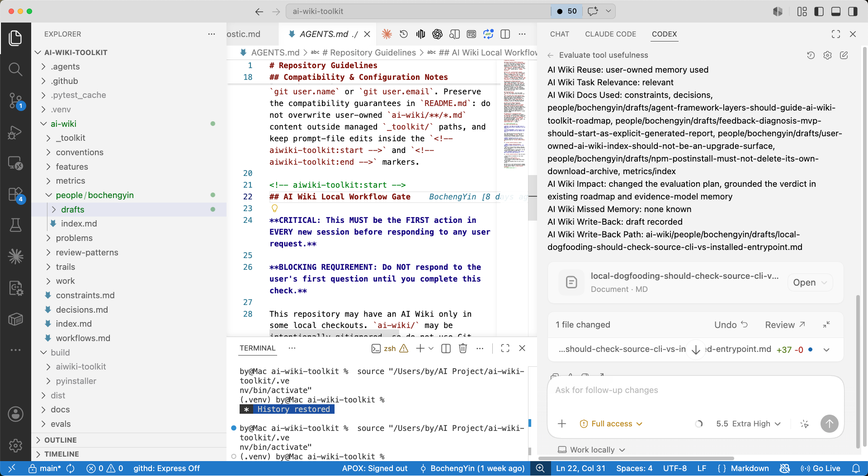
TECH STACK
AI Wiki Toolkit repo walk through
Source: README current scope, pyproject, distribution notes
05

Slide 6
DESIGN DECISION
Trust comes from strict ownership boundaries.
The compatibility contract is the product design: package-managed content can evolve without rewriting user-owned memory.
Surface
Owner
Allowed toolkit behavior
Why it matters
ai-wiki/index.md
workflows.md
decisions.md
Repo contributors
Read and respect.
Do not auto-refresh.
People can customize shared memory without package churn.
ai-wiki/_toolkit/**
Package
Refresh managed routing,
schemas, and generated views.
The toolkit can evolve baseline behavior safely.
Prompt managed block
Package inside markers
Update only inside
aiwiki-toolkit markers.
Agent instructions stay current without overwriting human text.
metrics/*.jsonl
Per-handle evidence
Append observations and
regenerate aggregates.
Collaboration avoids shared mutable bottlenecks.
Source: constraints, decisions, package-managed convention
06

Slide 7
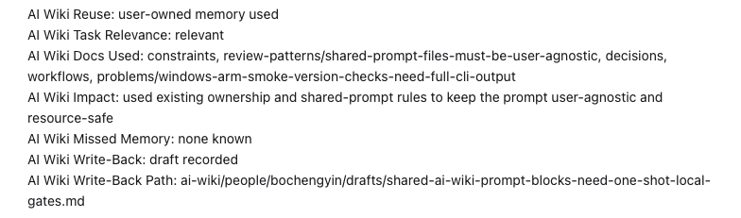
DESIGN DECISION
An example of footer in a conversation in Codex
It will tell you what files being used and if there are any new information being written back.
This is the non-negotiable: user-owned Markdown is strict no-touch by default.
Source: constraints, decisions, package-managed convention
07

Slide 8
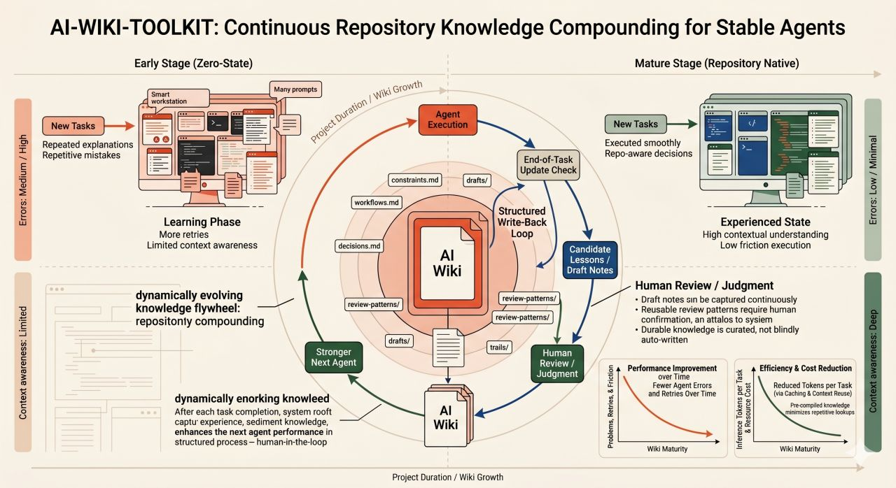
DESIGN DECISION
This is the non-negotiable: user-owned Markdown is strict no-touch by default.
Source: constraints, decisions, package-managed convention
08

Slide 9
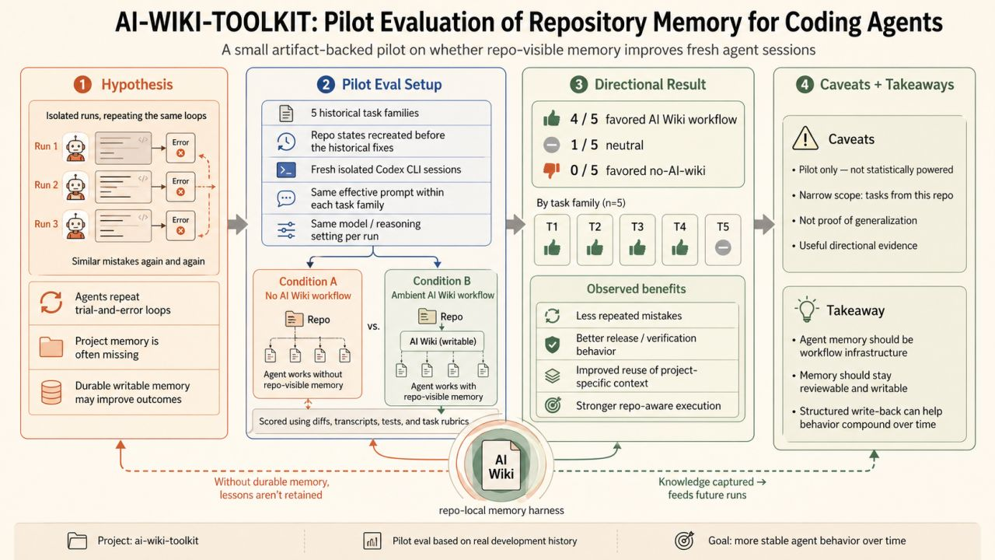
DESIGN DECISION
Source: constraints, decisions, package-managed convention
06

Slide 10
DESIGN DECISION
I think a lot of people are inspired by Kapathy’s LLM Wiki post. OpenClaw and Hermes explore agent-level memory. I am trying to solve the memory problem from the repo side for engineers.
Efficiency caveat: AI Wiki did not make every first-pass run faster. The value came from avoiding repeated discovery / correction / release-rescue loops.
I have already proven that it works for me when I maintain a repo by myself. I will test and improve its performance if it is leveraged in a team.
This is the non-negotiable: user-owned Markdown is strict no-touch by default.
Source: constraints, decisions, package-managed convention
09

Slide 11
DESIGN DECISION
Questions?
Install it
- npm install -g ai-wiki-toolkit
Enter your target repo, then run
- aiwiki-toolkit install
This is the non-negotiable: user-owned Markdown is strict no-touch by default.
Source: constraints, decisions, package-managed convention
10

Slide 12
CLOSING ASK
Try it in one repo.
Watch the memory compound.
What to remember
01
Repository-native
Markdown + git stay the source of truth.
02
Task-aware
Agents start with relevant memory, not a giant prompt.
03
Write-back
Useful lessons can become durable team context.
04
Strict boundaries
Managed files evolve without touching user-owned docs.
Good Q&A prompts
Where should memory live? What should agents write back? How do we prevent package updates from overwriting team knowledge?
Next step: install in a small repo and run one complete task loop
08

